Slide 1
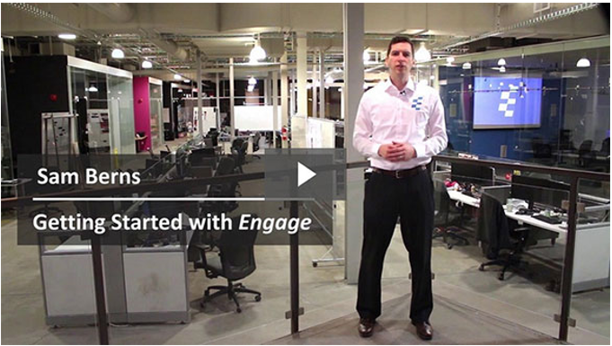
Welcome friend :-)
Let’s build an amazing presentation together.
Follow along at any time:
https://markido.com/help/10/getting-started-with-engage

Slide 2
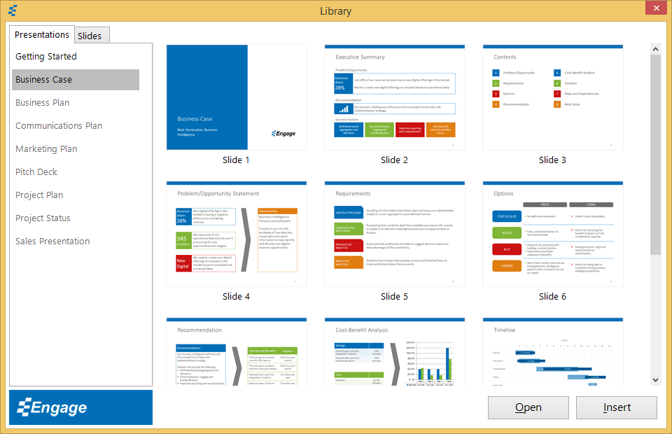
Presentation and Slide Library
Instructions
Beginner
Watch Video
Click the Presentation Library button from the Engage tab.
Select Business Case and click the Open button.
Click on the Slide Library button from the Engage tab.
Select any slide and click on the Insert button.

Slide 3
SmartObjects
Insert SmartObject here
Instructions
Beginner
Watch Video
Click the SmartObjects button in the Engage tab.
This will open the SmartObjects task pane.
Drag and drop the 4 Boxes SmartObject onto this slide.
Close the SmartObjects task pane when finished.

Slide 4
Elements
Instructions
Beginner
Watch Video
Click the Elements button from the Engage tab.
Drag and drop an icon on the empty circles above.
Select the icon, resize and change the shape fill color the way you would any PowerPoint shape.
Find more design elements from the Element drop-down menu (e.g. Flowcharts, Wireframes, Callouts, Calendar and Charts).

Slide 5
Infographics
Insert pictogram infographic here
Insert doughnut chart infographic here
Instructions
Intermediate
Watch Video
Click the Infographics button from the Engage tab.
Select the Doughnut infographic and click the Insert button.
Change the Value % to 83% and close the dialog window.
Try doing the same with the Pictogram but this time click on Edit Data to update the values.
Select the infographic and click on the gears on the top right to reopen the infographic dialog window at any time.
83% of PowerPoint users wish they could create better visuals.

Slide 6
DataMaps
Results by Country
Insert DataMap here
Instructions
Intermediate
Watch Video
Click the DataMaps button from the Engage tab.
Select the North America by Country map.
Click on Edit Data to update the values in Excel, then close the Excel file.
Click on the Legend button.
Check the Show Legend box and close the dialog box.

Slide 7
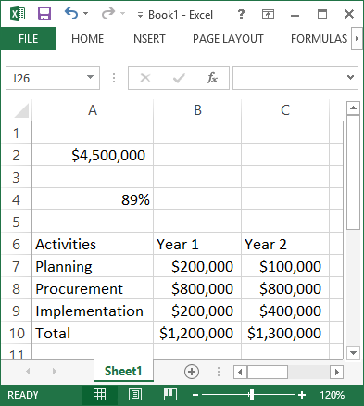
Automate
Instructions
Expert
Watch Video
Project Budget
2000000
Open a new Excel spreadsheet.
Type a number (e.g. $4,500,000) in any cell.
Type a percentage (e.g. 89%) in any cell.
Copy the data from the table here into Excel
Save and Close the Excel file.
Project Completion
71%
Click the automate button and select the Microsoft Excel option.
Click the Create a link button.
Select the text box with the value “2000000” and click Link Selected Shape.
Select the Excel file above and pick the cell from step 2 (e.g. $4,500,000).
Repeating the same steps as above, select and link the progress bar infographic and then the data table on the left of this slide.
Activities | Year 1 | Year 2
Planning | $200,000 | $100,000
Procurement | $800,000 | $800,000
Implementation | $200,000 | $400,000
Total | $1,200,000 | $1,300,000
Click Reload Values to update any shape, infographic, chart or data table in your presentation based on the latest values in your source file.

Slide 8
SmartGrid
Instructions
Intermediate
Watch Video
Click the SmartGrid button on the Engage tab to show/hide the grid.
Uncheck the Aspect Ratio button in the Size section to the right of the SmartGrid button.
Select the chart below and click Align to Grid and select 1 (this will align the chart to the first column).
With the chart still selected, click the Width columns drop-down under the Aspect Ratio check box and select 12 (this will set the width of the chart to 12 columns wide).

Slide 9
SmartColors
63% Android
27% Apple iOS
5% Blackberry
2% Windows Phone
4% Others
Instructions
Beginner
Watch Video
Click the Color Swatches drop-down in the Engage tab and select a different color swatch.
Select the pie chart above and click on a color from the Engage Shape Fill drop-down in the SmartColors section.
You can also create your own color swatch by selecting My Swatches at the bottom of the Color Swatches drop-down.

Slide 10
Flow
Instructions
Intermediate
Watch Video
Elements
Click Start Presentation under the Flow button
Next slide:
right arrow key or space bar
Previous slide:
left arrow key
Exit:
press Esc to exit
Update this Flow presentation
Click the Flow button.
Click Add Step.
Select the Next Steps square on the left, then click Use Selected Shape to confirm.
Then click Add Slide and select Slide 12.
83%
Infographics
Next Steps

Slide 11
Accessibility
Instructions
Intermediate
Watch Video
Step 1
Select the Step 1 Text Box.
Click the Accessibility Check drop down triangle, then select the Color Checker option.
Select a darker background color that passes the color contrast tests.
You can also click on the Automatically adjust colors so that they pass button.
Click the Apply Colors button.
Step 2
Step 3

Slide 12
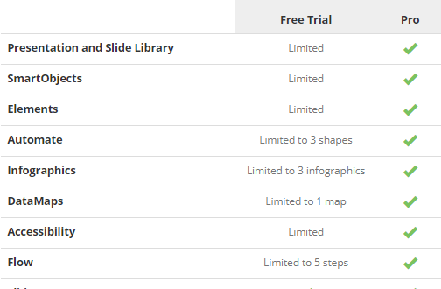
Next Steps
Take your presentations to the next level with the pro version.
Upgrade for only $19/month (billed annually).
Upgrade to Pro

